Slide 1
King County Housing
By Deric Williamson & Eric Cusick

Slide 2

Business Case
A home renovation contract team has employed the services of data scientists to create a model predicting how much a house will sell for in the King County, WA area.
Given the ‘kc_house_data.csv’ file, the data scientist team is expected to:
Build an accurate predictive model
Report some of the primary features of a house that will increase the price so the company will know what to focus their efforts on
Build a calculator that represents the model

Slide 3
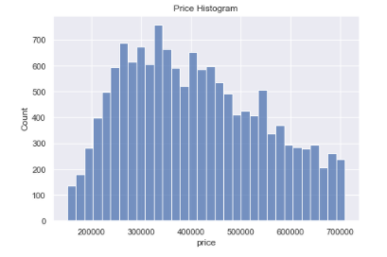
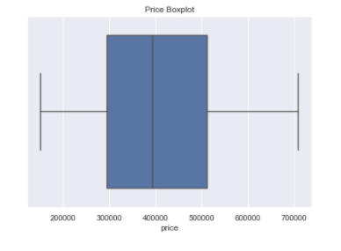
Exploratory Data Analysis (EDA)
Using the provided data from: kc_house_data.csv
We restricted our data to provide a more meaningful relationship to our model by analyzing data from a house price range from $150,000 to $710,000.

Slide 4
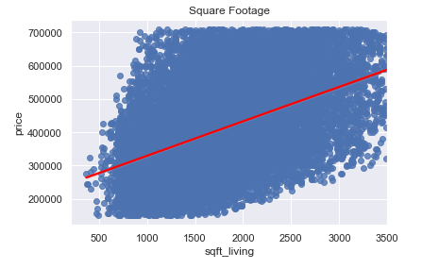
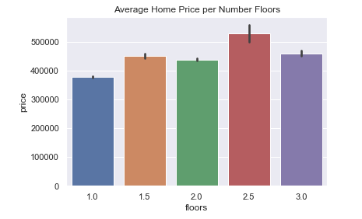
Exploratory Data Analysis (EDA)
Some other house features were analyzed and corrected from possible outliers, data types, and missing data.
For regression accuracy purposes, we decided to drop house square footage data that was above 3,500 square feet. The graph reflects linearity.
On average, a house with more than one floor will sell at a higher price than a home with only a single floor.

Slide 5
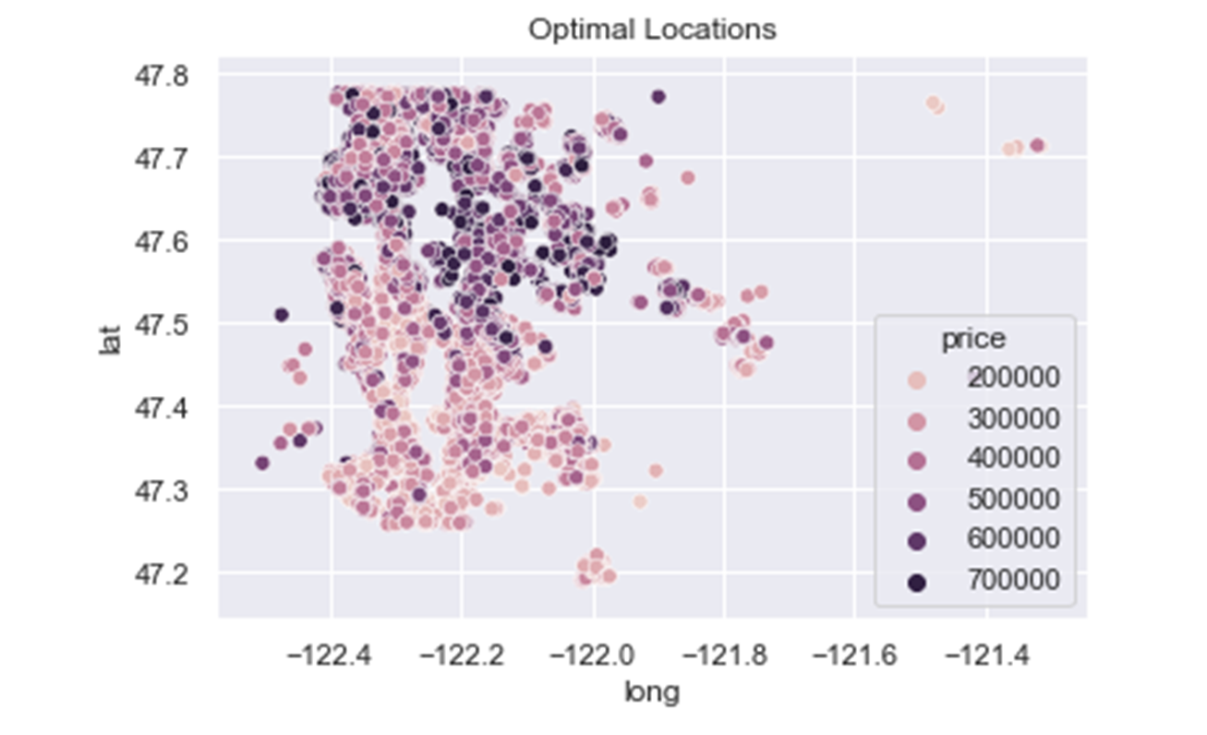
Exploratory Data Analysis (EDA)
In King County, the location of the home can have a large impact on how expensive the home sells for. The graph shows the more expensive homes in the county are towards the northside, and lower priced homes are in the south.

Slide 6
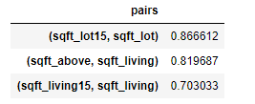

Modeling Process
During the modeling process, we:
High Collinear Examples:
Removed collinear variables
Highly correlated features might alter after changing one feature
Detecting high P-values
High p-values assume there is little to no relationship in outcome
Log transformed house square foot
Will help with model accuracy
Categorized zipcode into four categories
Zipcodes were categorized by price and frequencies found in raw data
P-Values
Little to no relationship on outcome

Slide 7
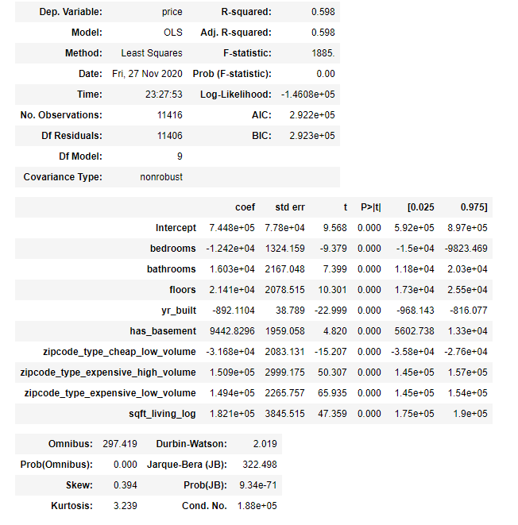
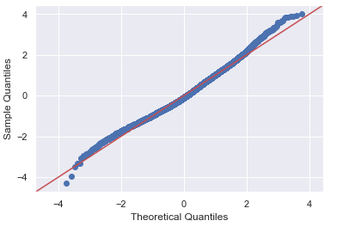
Final Model
R-Squared is a statistical measure between 0 and 1 which calculates how well the regression line fits in our data set.
A coefficient is an indicator for each unit of “x” that is equal to the difference in outcome
Next our recommendations…

Slide 8

Recommendations
Looking at our model, we recommend:
Size, location and the number of floors have the biggest influences on house prices
More expensive homes are located on the northside of the county, while less expensive homes are in the south
It's better to have an additional bathroom over an additional bedroom
Year Built has the lowest impact on resale price
We believe that the renovation team will be able to utilize this information to make sound decisions, to potentially increase their profits and work with efficiency when fixing homes.

Slide 9

Predictive House Sales Calculator
Bedrooms 3
Bathrooms 2
Floors 1
Year Built 2005
Has Basement No
Zipcode 98178
House Sqft 1200
Estimated
Price $231,927
Based off our model, we created a calculator that inserts the housing features to output the predictive housing prices.

Slide 10

Future Work
Add to the dataset to explore the price difference between rural and urban homes
Possibly restrict the model further by choosing only urban or rural locations
Create more features from web scraping to increase the accuracy of the model
Distinguish a correlation between housing prices and school district placement

Slide 11

Thank You!!!!
Thank you to our audience for giving us your time and attention during our presentation today.

